Slide 1
Analyzing Student Success
Ctrl Alt Defeat
Sam Holmes, Teo Mendoza, Ben Webster, and Mia Parker

Slide 2
How does success across learnosity question types influence students’ overall success?

Slide 3
Hypothesis and Thoughts
Hypothesis: There are learnosity question types that certain groups of students succeeded at more than others.
In order to make our data analysis simple, we only used information from the College / Statistics and Data Science (ABC) book.
To test our hypothesis, we first merged each csv by student_id, so we had all information for that student in one location.
We then grouped them into 4 groups corresponding to their percentile based on EOC response correctness across chapters. (25th, 50th, 75th, 100th).
We then analyzed the EOC averages of each learnosity question type in hopes of finding patterns based on students’ percentile.
We’ll use this information to make recommendations to CourseKata on how best to work towards their goal of improving statistical learning.

Slide 4
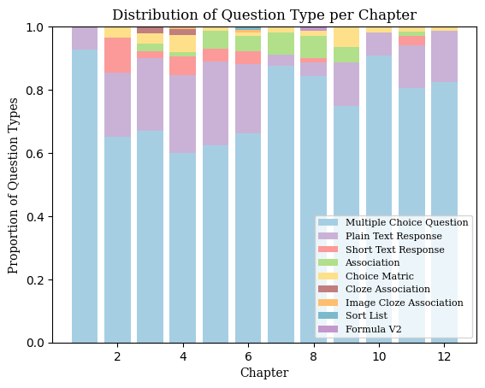
Graph 1: Distribution of Question Type per Chapter
Observations:
Multiple choice questions make up the majority of questions in each chapter
Long text response have the second highest probability
Ordering problems are only present in one chapter
Notes:
Color Codes: blue1: #A6CEE3, purple1: #CAB2D6, red: #FB9A99, green: #B2DF8A, yellow: #fee08b, purple2: #c17e7f, orange: #FDBF6F, blue2: #7cb9cb, purple3: #c497cd
In graph 1, we can see the distribution of question types per chapter. This was calculated using the items.csv which contains the type of question and the amount of that type for each chapter. It was then a process of calculating the probability instead of a number.
From this graph we can see that the majority of questions within each chapter are multiple choice, with the second highest type being long text problems.

Slide 5
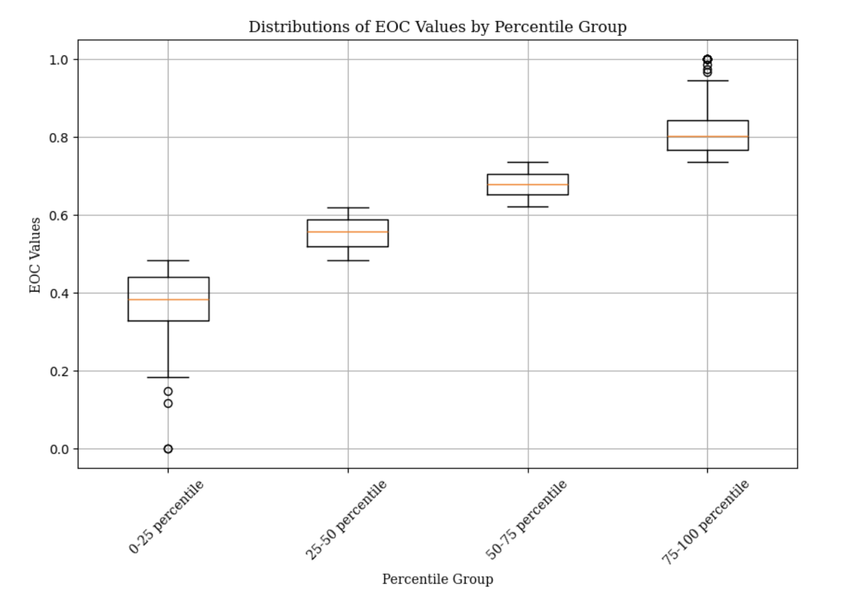
Graph 2: Distribution of EOC Values by Percentile Group
Observations:
25%-50% and 50%-75% have the least variations in scores
0%-25% has the most amount of variation
75%-100% has the most amount of outliers
Notes:
Define EOC
In graph 2, we have the distribution of EOC values, grouped by percentile values. This was found by finding the average EOC of each student and then grouping them into 25% portions. We then graphed these as boxplot to see individual distribution
We can see that 25%-50% and 50%-75% have the least variations in scores while 75%-100% has the most amount of outliers.

Slide 6
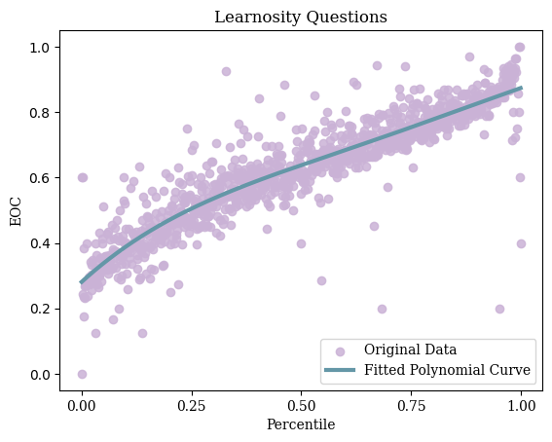
Graph 3: Percentile vs EOC for total Learnosity Questions
Observations:
Fairly positive linear correlation
We can see a slight incline in performance within the 25th percentile

Slide 7
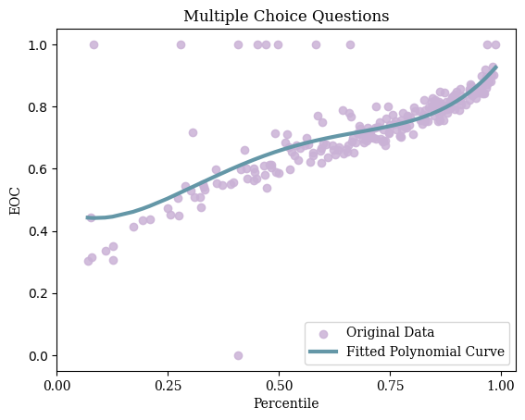
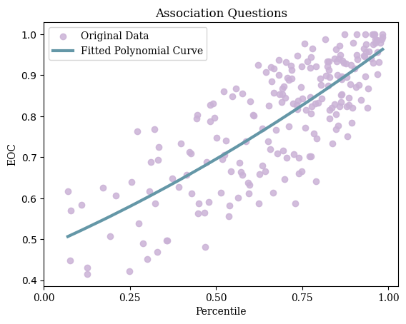
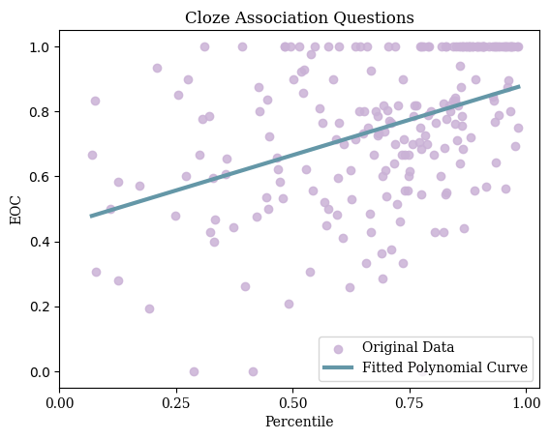
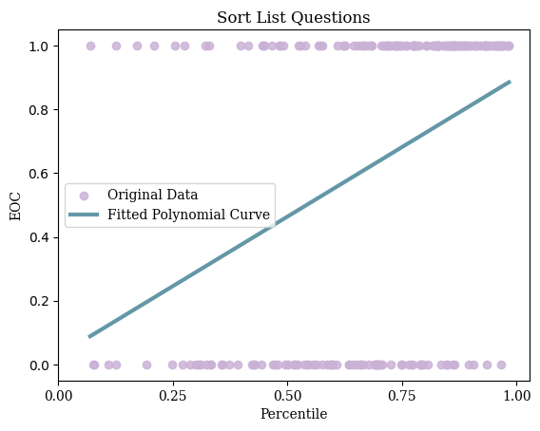
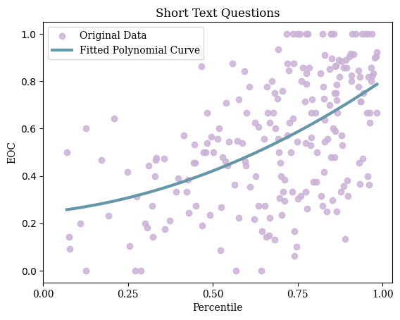
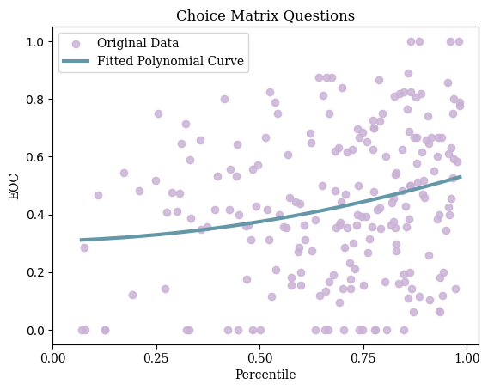
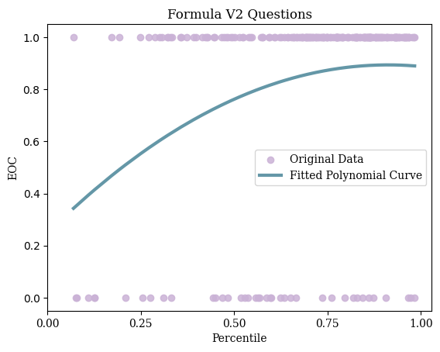
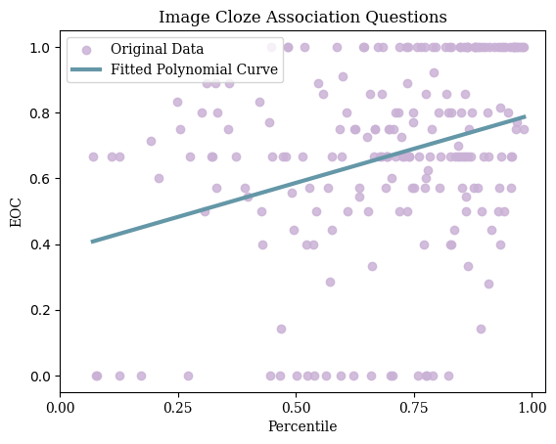
Graph Group: EOC for Type of Learnosity Question by Percentile
785 MC Questions
28 Association Questions
5 CA Questions
1 SL Question
35 ST Questions
45 CM Questions
1 FV2 Question
2 ICA Questions

Slide 8
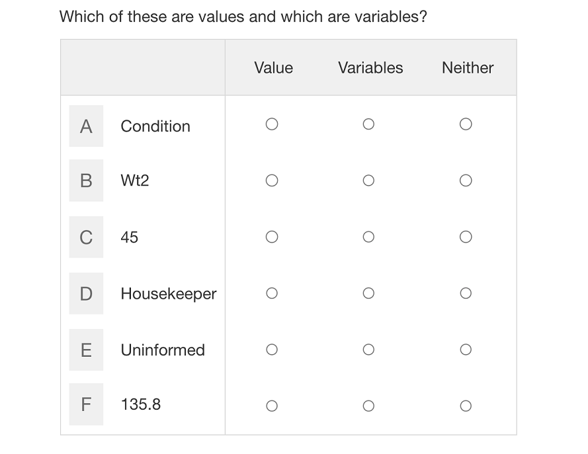
Graph 4: Choice Matrix Questions
Observations:
Little difference between the average Choice Matrix EOCs of students who performed better overall and those who did not
Notes:
This suggests that Choice Matrix questions are less effective and should be replaced with more effective question types.
Even top-performers are struggling with these

Slide 9
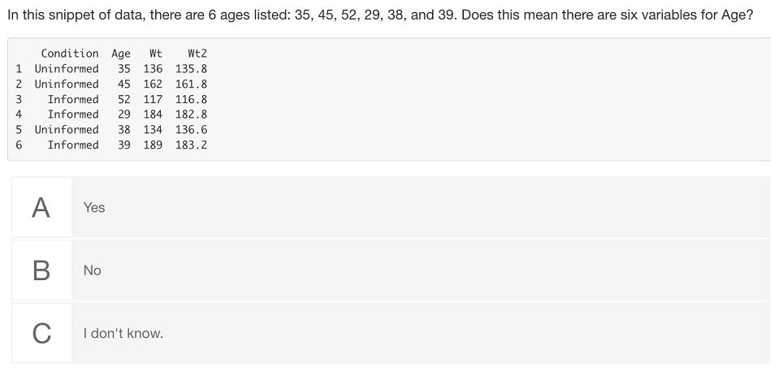
Graph 5: Multiple Choice Questions
Observations:
Fairly positive linear correlation
Steeper incline within 0%-25% and 75%-100%
Steadies off(flatter) in the middle 50%

Slide 10
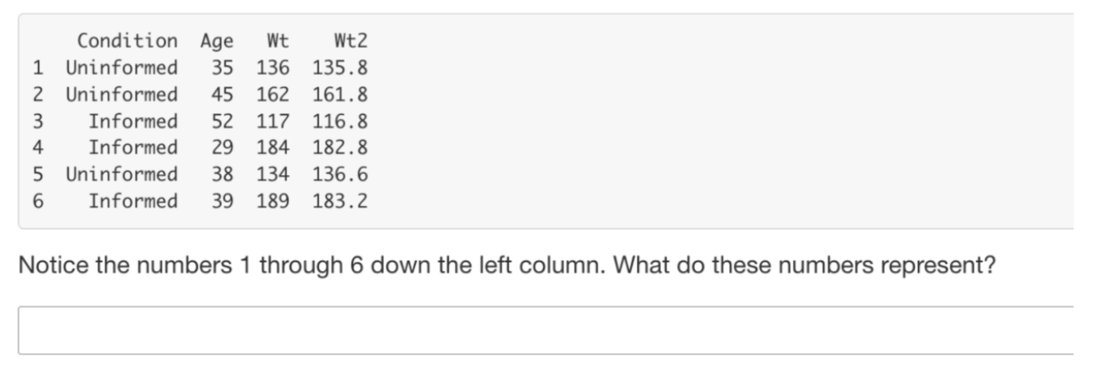
Graph 6: Short Text Questions
Observations:
Somewhat positive linear relationship between percentile and EOC
Data is very scattered throughout the graph

Slide 11
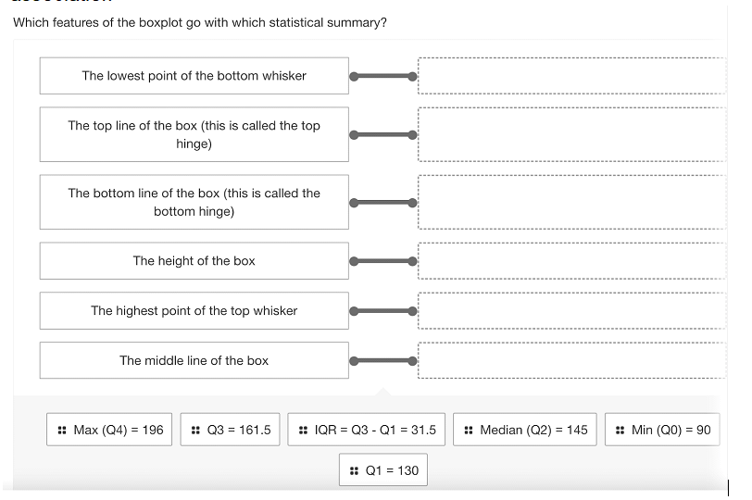
Graph 7: Association Questions
Observations:
Students EOC increases as rank percentile increases
Higher rank percentile shows increased ability to answer association questions

Slide 12
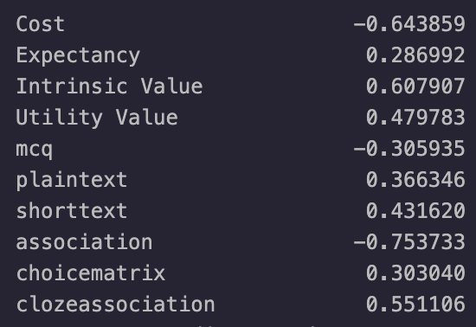
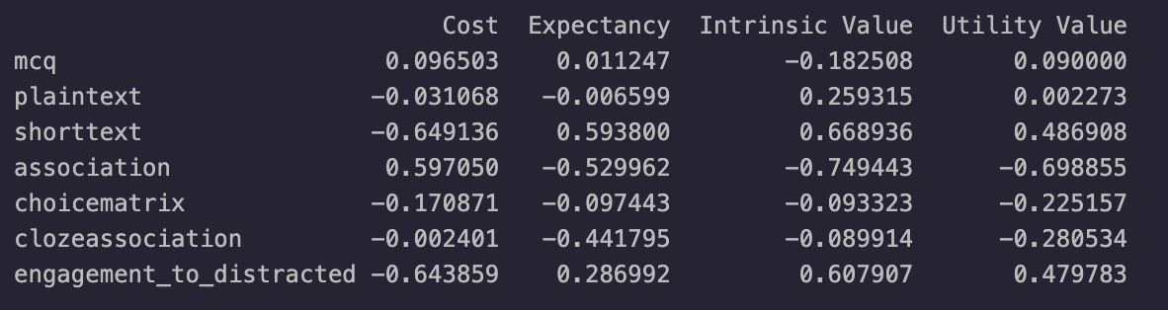
Correlations Between Question Type and User Satisfaction
We compared the proportion of questions present within a chapter to the user response in the pulse check:
Correlation to Engagement/Idle ratio
Values to question type

Slide 13
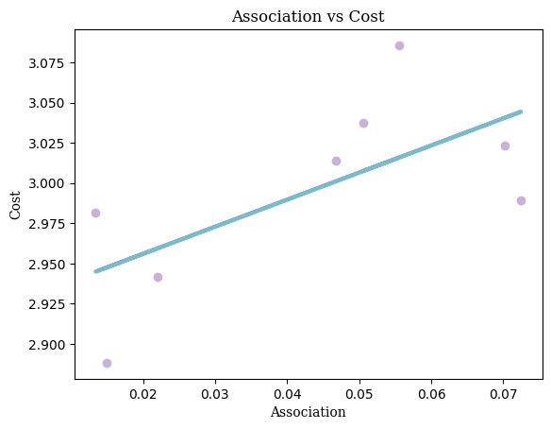
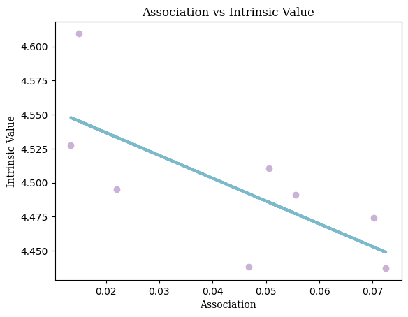
Association Questions
Students likely perceive the Association questions as time intensive, unengaging, and with little value.
Ability to answer association questions is a strong indicator of a student’s knowledge

Slide 14

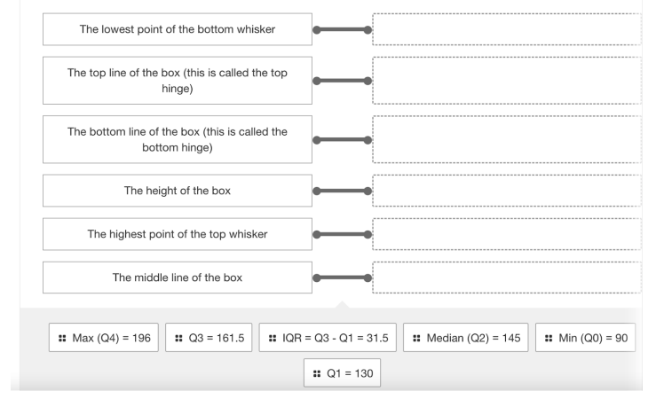
Solution to Association Questions
Use to evaluate a user’s capacity
Reduce quantity in practice and homework

Slide 15
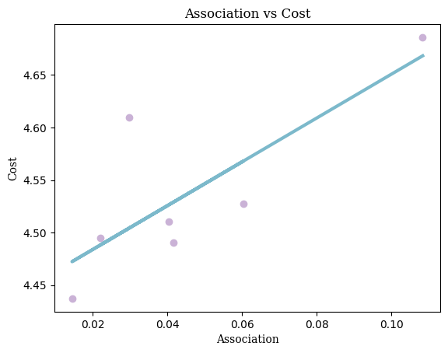
Short Text Questions
Weaker students answer a fewer number of these questions
Solution: Increase engagement by naturally guiding students into the question
Chapters with a larger number of these questions are perceived more positive across the board
Solution: Increase the number of short test questions. Allow students to explain their confusion for partial credit

Slide 16
Our Recommendations
Notes:
Here are some recommendations to help CourseKata reach their goal of improving statistical learning.

Slide 17
Volunteer Response Bias
Fully integrate an “I don’t know” option.
Keep students from getting ahead of themselves.
Notes:
When analyzing students’ response data, we ran into some roadblocks. The data is riddled with holes left by students who skip questions. Multiple choice questions give students the option to give an “I don’t know” response, and we suggest that CourseKata adds this feature to other question types. Additionally, students should not be allowed to continue through the curriculum without confirmation that they are ready to move on. One way this can be achieved is by giving students a limited number of submissions per question. If they reach the limit, they’re sent back to the relevant section of the chapter to refresh their memory before attempting the question again. Not only would this make sure students are prepared before moving on to new sections,but it would fill holes in the data and make further analysis feasible.

Slide 18
Not all questions are created equal.
Some questions-types are poor indicators of student success.
These questions should be altered or replaced with questions that are more helpful.
Notes:
Not all questions are created equal. With some question-types, such as Choice Matrix, the highest performing students have an average accuracy that is similar to the weakest students. This suggests that questions like these are poor indicators of student performance. These questions should therefore be altered or phased out all together in favor of questions-types that contribute more to students’ success.

Slide 19
The End
Thank you for listening!

